Slide 1

Phishing Awareness Training
Ishika S. Kashyap

Slide 2
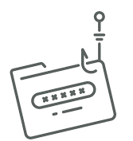

Introduction
Greetings and welcome to our phishing attack, training module.
In today's digital world, phishing attacks happen frequently as they pose significant risks to individuals as well as organizations.
This workshop will cover the definition of phishing, its different symptoms, and effective ways to spot and handle phishing efforts.

Slide 3
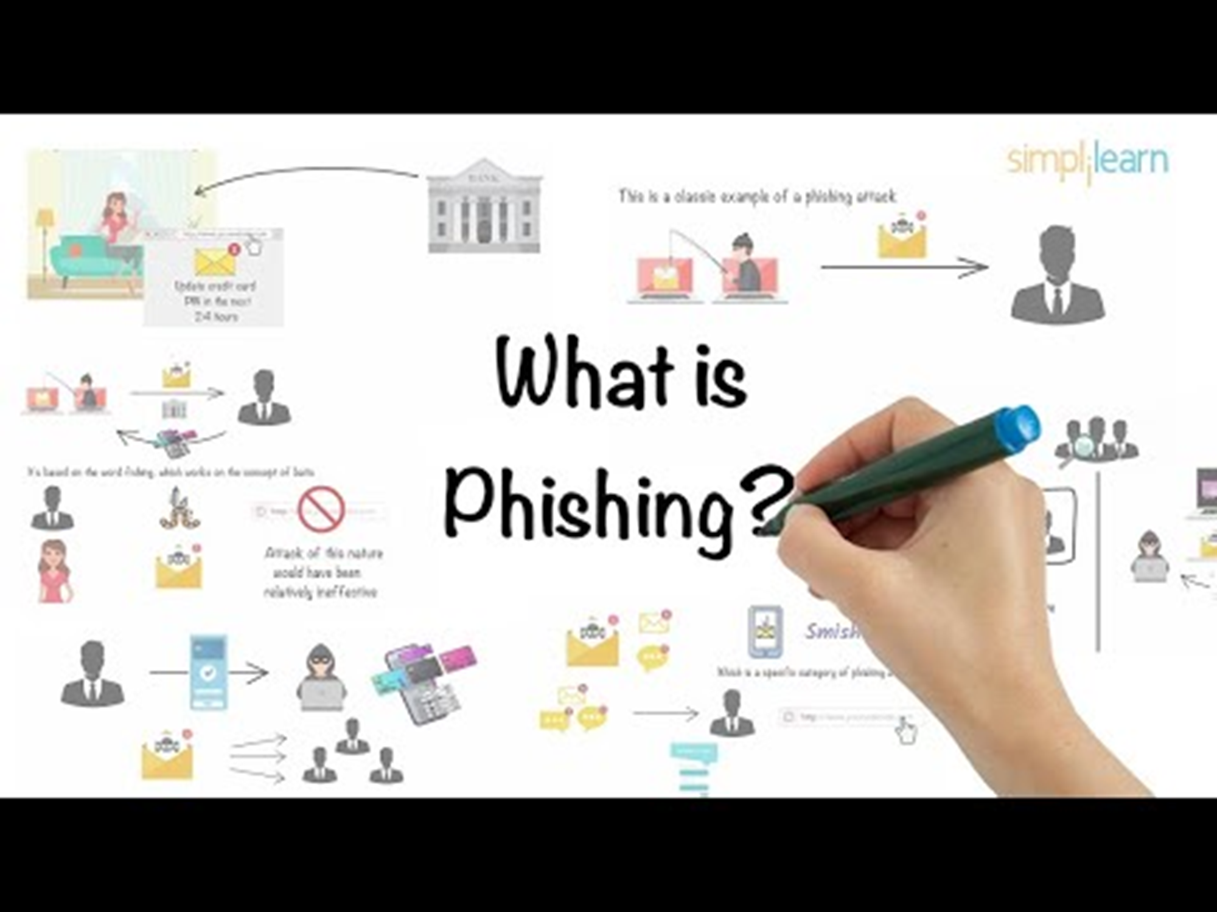



Slide 4
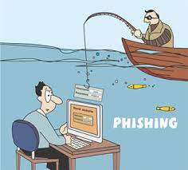

Phishing is a type of cyberattack in which attackers assume the identity of trustworthy organizations in an attempt to trick victims into disclosing private information, such passwords, bank account information, or personal information.
Email is usually included, although phone conversations, texts, and social media can also be used.
The goal of phishing attacks is to trick victims into taking actions that benefit the attackers, such as clicking on malicious links, downloading infected attachments, or providing sensitive information. These attacks often rely on psychological manipulation tactics to create a sense of urgency, fear, or curiosity to prompt victims to act without thinking critically.

Slide 5


Identifying Phishing Emails
Sender Address
Tone and Urgency
Look for suspicious or generic email addresses that don't match the claimed sender.
Be wary of emails that create a sense of urgency or threaten consequences for inaction.
Spelling and Grammar
Poorly written emails with typos and grammatical errors are often a sign of phishing.

Slide 6

Smishing
Spear Phishing
Whaling
Email Phishing
Vishing
Types
Of
Phishing
Types of Phishing Attacks

Slide 7

Common Phishing Tactics
Impersonation
Urgent Requests
Phishers may pretend to be from a trusted company, organization, or government agency to lure victims.
Phishing emails often create a false sense of urgency to pressure victims into taking immediate action.
Malicious Links
Fake Attachments
Phishers include links that lead to fake websites designed to steal sensitive information.
Phishing emails may contain attachments that, when opened, install malware on the victim's device.

Slide 8
Protecting Yourself from Phishing
Verify Legitimacy
1
Always double-check the sender's email address and website URL before taking any action.
Avoid Clicking Links
2
Do not click on links or open attachments in emails from unknown or suspicious sources.
Use Strong Passwords
3
Employ unique, complex passwords for all your accounts to prevent credential theft.

Slide 9
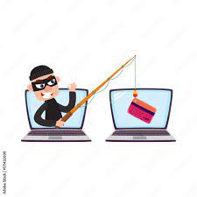
Protecting Personal and Organizational Data
Stress the importance of safeguarding personal and organizational data against phishing attacks .
Emphasize the need for strong passwords, two-factor authentication, and regular data backups to mitigate risks .
Provide guidance on securely sharing information and conducting transactions online.

Slide 10



Reporting Phishing Attempts
Forward to Authorities
Contact Your Bank
Report phishing emails to the relevant authorities, such as your email provider or the FTC.
If you've shared financial information, contact your bank or financial institution immediately.
Report Suspicious Websites
Notify website owners or security teams about any suspected phishing websites.

Slide 11
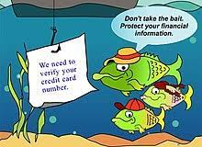
Impact of Phishing
Identity Theft: Phishing attacks can lead to identity theft, where attackers use stolen information to impersonate victims or access their accounts.
Financial Loss: Victims may suffer financial losses through fraudulent transactions, unauthorized access to bank accounts, or compromised credit card information.
Data Breaches: Successful phishing attacks can result in data breaches, exposing sensitive corporate or personal information to unauthorized parties.
Reputation Damage: Organizations targeted by phishing attacks may experience reputational damage, loss of customer trust, and legal consequences due to compromised data security.

Slide 12

Preventing Phishing Attacks
Security Awareness Training
Vigilance
Email Filtering
Security Software
Multi-Factor Authentication (MFA)

Slide 13
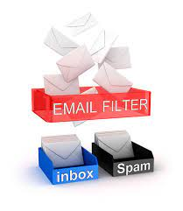
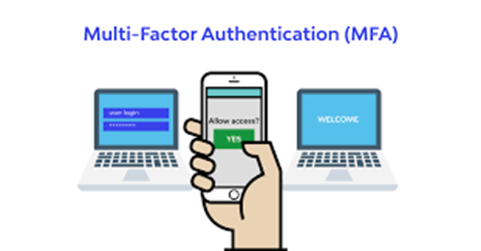
Email Filtering: Implement email filtering solutions to detect and block phishing emails before they reach users' inboxes.
Multi-Factor Authentication (MFA): Require users to use MFA to add an extra layer of security when accessing sensitive accounts or information. Key Components of MFA-
Something You Know
Something You Have
Something You Are

Slide 14
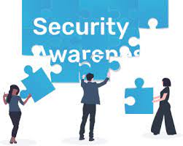


Security Awareness Training: Educate users about the dangers of phishing and provide training on how to recognize and respond to phishing attempts.
Security Software: Install and regularly update antivirus, anti-phishing, and firewall software to protect against phishing attacks and other cyber threats.
Vigilance: Encourage users to remain vigilant and skeptical of unsolicited communications, especially those requesting sensitive information or urging immediate action.

Slide 15
Conclusion
Phishing attacks continue to pose significant threats to individuals, organizations, and the overall cybersecurity landscape.
By understanding the different types of phishing attacks, recognizing common characteristics, and implementing proactive security measures, users can better defend against phishing attempts and protect their sensitive information from falling into the hands of cybercriminals.
Ongoing security awareness training and a commitment to best practices are essential in mitigating the risks associated with phishing and maintaining a secure online environment.

Slide 16
Phishing is a widespread and evolving threat. | Identify phishing attempts requires attention to details.
Remain vigilant and skeptical of unsolicited request for sensitive information. | Report any suspected phishing incidents to the appropriate authorities.
Protecting yourself and your organization is crucial | Ongoing education and security measures are essential to prevent phishing attacks

Slide 17
THANK YOU…..

